Slide 1
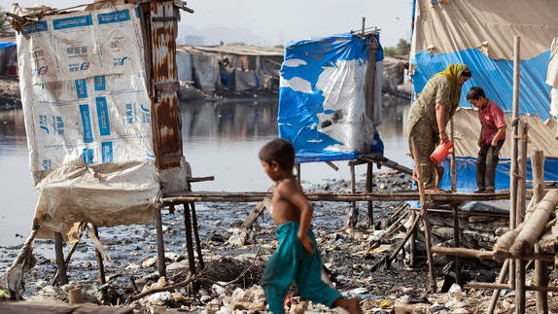
Nationwide the problem of providing toilet and clean hygiene is increasing every day, can we not find a fast solution, without compromising on the quality that the world class product should have for good toilets in villages, schools & public
67 years later we are still finding solutions for Good Toilets for 40% of Nation and still have Scavengers and women are still ashamed to go in open !!
Thanks god our pm wants early solution and we now realize that cost is not a concern, solution is important
Do we want this situation in India ?
IF NOT WE REALLY NEED TO THINK RADICALLY, WITH INTERNATIONAL ORIENTATION AS ON DATE
WE NEED 30 MILLION TOILETS, i.e. 3 Crores ???

Slide 2
"Nearly 60% of the people in the world who defecate in the open belong to India. Even countries like Bangladesh, Nepal, Pakistan and Afghanistan have better records. We should be ashamed of this," Ramesh said, proposing that women self-help groups should now be used in the Nirmal Bharat Abhiyan.
Being ashamed of ourselves, let us not ponder of what was past, lets start worrying about what we are loosing and what can be done faster , like the way the Cellular phones came to our country and today, we never realized that more than few million people use phones which are costlier than Rs. 25,000 a piece and some of them are more than Rs. 40,000, We never realized that iPhones costing more than Rs. 50,000 would be used so easily in our country, forget about iPads and Apple etc. computers,….. So lets analyze the cost of such a failure

Slide 4
The result of reputational loss as a Filthy and Dirty country is harmful in more than one
Read this observation by one of the reputed online magazines circulating this news .

Slide 5
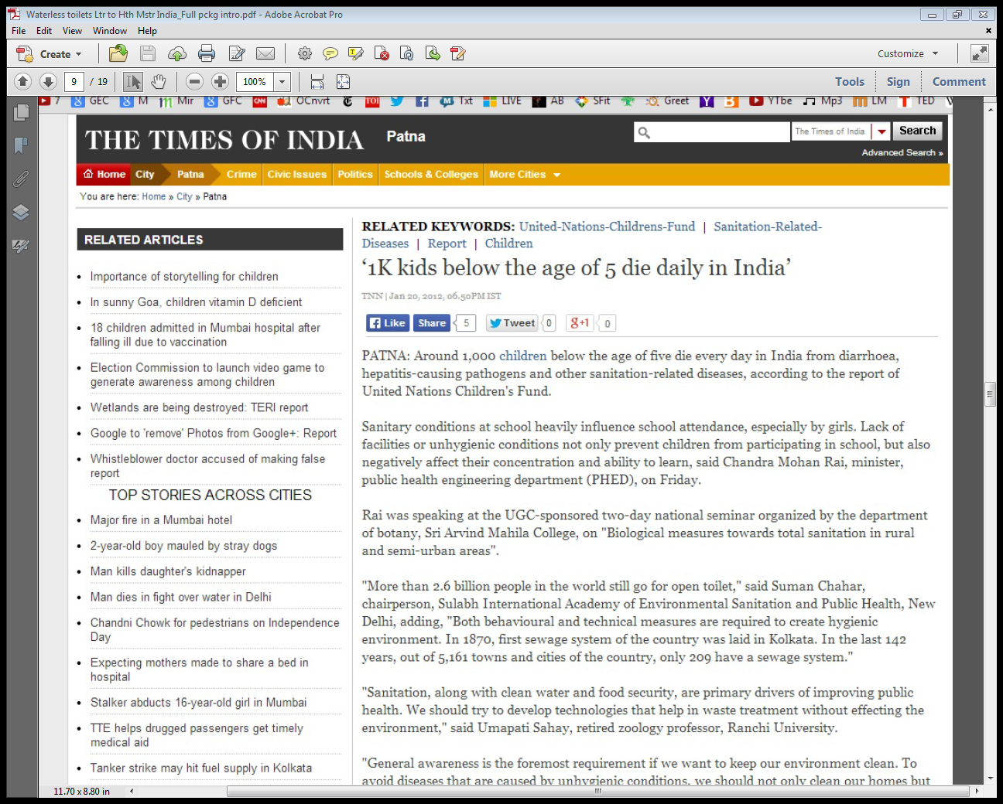
More than 1000 kids die below the age of 5, every day, a great human-capital loss in Millions of Rs. Every day, apart from the woes of the parents that remain helpless

Slide 6
Please read this alarming figure, from some of the top notch institutions in the world
All this is not in multiple number of years, but in 1 year of Health and other costs

Slide 7
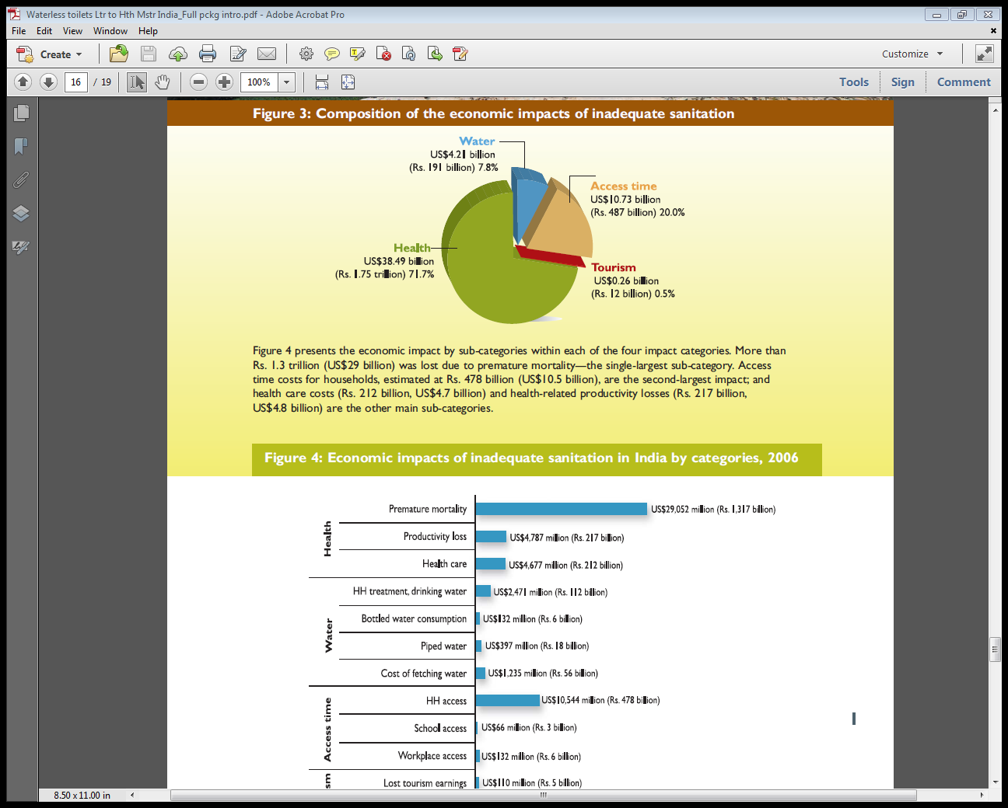

Slide 8
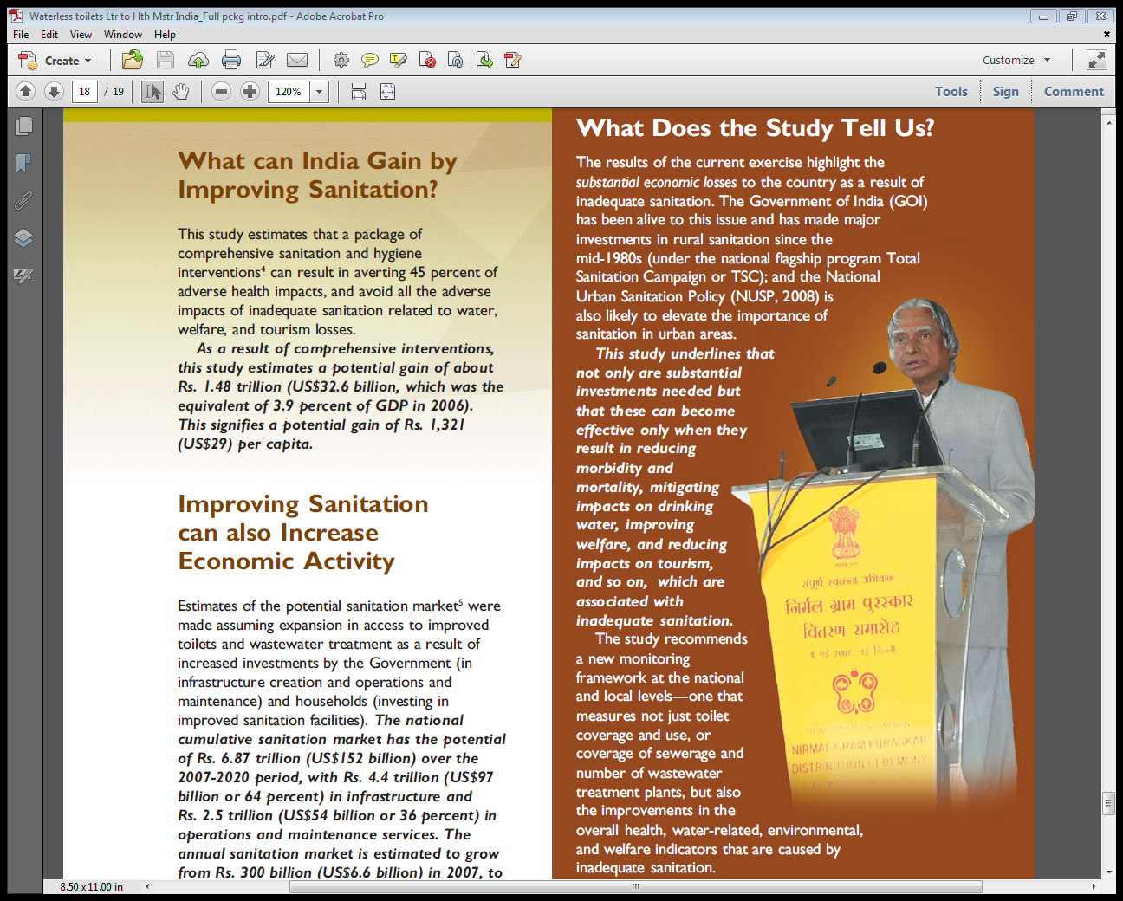
Ladies and Gentleman, lot many such reports are there in NGO and Govt. files, but still nothing was done and these figures are on 2006 basis, we increased our population by another 12% in the last 7 year since 2007, so our loss of human capital and economic losses have increase much more, … SO NOW IS THE TIME TO ACT FAST.

Slide 9
Out of the 30 Million toilets we need, certainly 1.5 Million are urgent, while other can keep on building in the traditional manner over a period of time, lets look at the WATERLESS TOILETS, WHICH IS AN IMMEDIATE REPLY IN NEXT 3 – 30 MONTHS.

Slide 11
Offers World class Waterless Incinerating Toilets CE, TUV and UL Approved

Slide 14
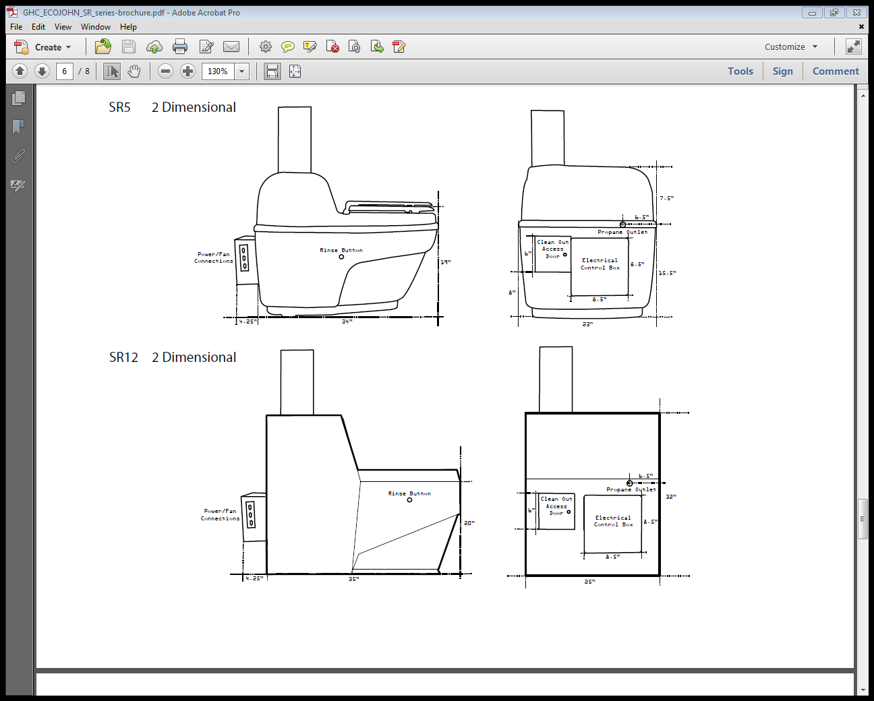
The installation processes are simple, and as for any such facility to be placed it has to be planned before-hand, so all other expenses are minimized and yet maximum benefit of the costs are received, while the Nation gets served in a unique way as well

Slide 15
FOR CLEAN PUBLIC HYGIENE, TOILETS ARE NOT THE ONLY THING TO BE TAKEN CARE OF EVERY WARD, EVERY STREET OUTSIDE ANY HOTEL, HOSTEL, MARKET, SHOULD BE KEPT CLEAN AND THESE SMALL “SMOKELESS” INCINERATORS BE INSTALLED INHOUSE, BY ALL SUCH BUSINESS / INSTITUTIONS, FACTORIES TO REDUCE THE THROWING OF WASTE OUTSIDE, SO THAT THE MUNICIPAL EXPENSES ARE REDUCED THERE AND THERE BY 35% IN ANY TOWN, FOR SURE

Slide 16
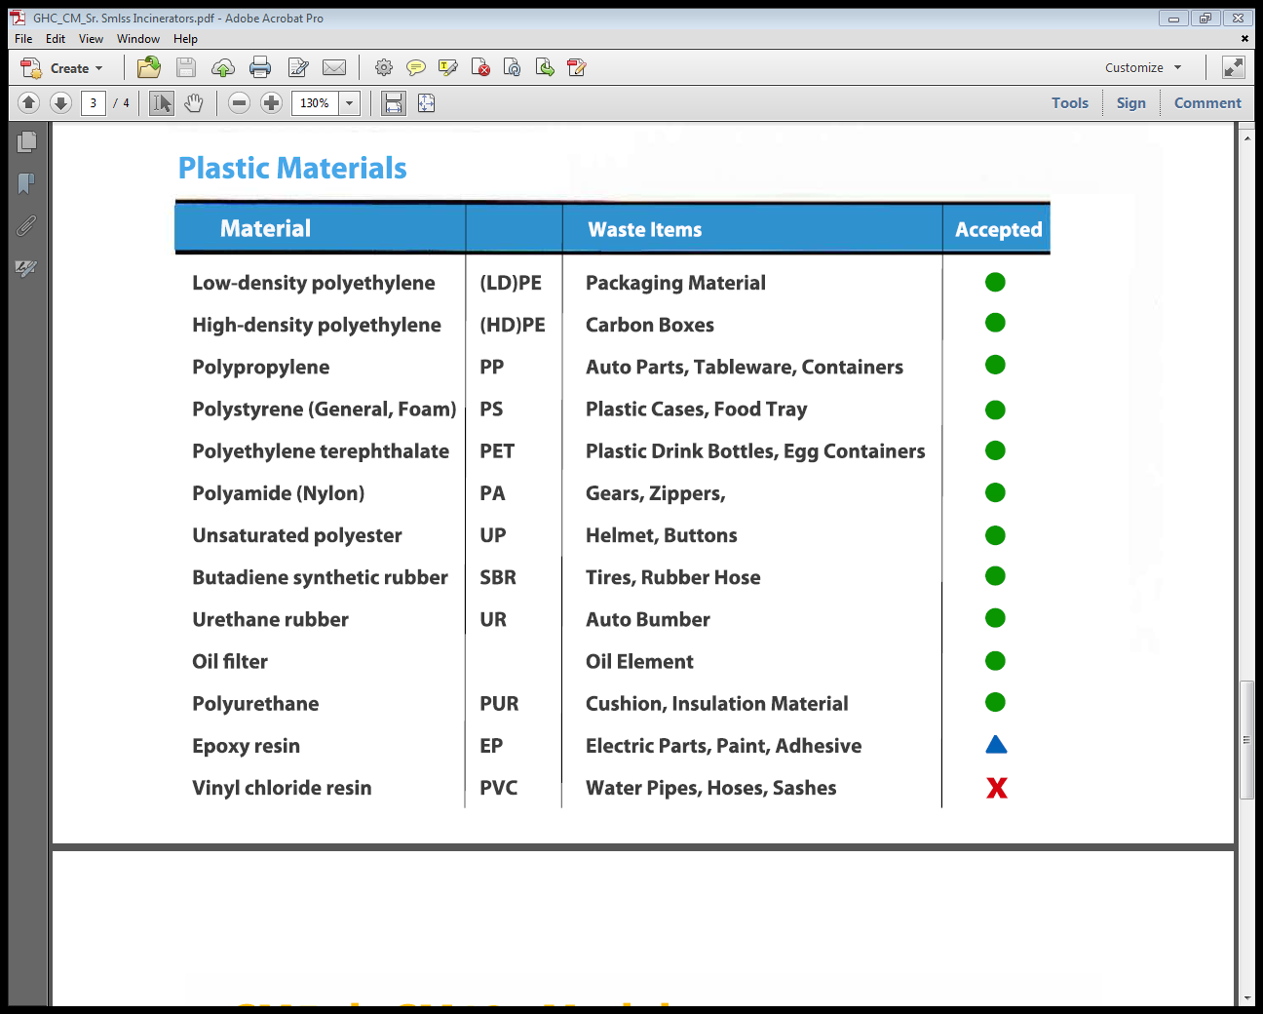
Apart from all the usual municipal solid organic etc waste these special smaller SMOKELESS INCINERATORS BURNS OF THE FOLLOWING MATERIALS WHICH ALL WOULD BE APPRECIATED BY ALLO SECTION OF PEOPLE, IF SUCH ITEMS ARE BURNED INHOUSE RATHER THAN THROWING AND INCREASEING THE WORK AND BURDEN OF THE MUNICIPAL BODIES, HENCE ENCOURAGE THESE THROUGH EFFECTIVE POLLUTION CONTROL METHOD

Slide 17
Thank you for sharing your concern for Better Public and Personal Hygiene and to make INDIA a much better place to live, smile and laugh with pride.
For setting up consultations and product design and procurement procedure please get in touch with our Regional Directors in India
This presentation was brought to you by our Regional Sales Director
Mr. Atul Rode of Pune, Maharashtra, for any requirement or questions
Please contact him on : 91-997-0515-8545

